Slide 1
Twitter Sentiment Analysis Using Natural Language Processing And Machine Learning
AKS VIBHAKAR
HU21CSEN0101156

Slide 2
Table of Contents
1. Introduction
2. Importance of Sentiment Analysis
4. Twitter Sentiment Analysis
3. Methodology

Slide 3

1.
Introduction

Slide 4
What is NLP ?
Natural language processing (NLP) is the ability of a computer program to understand human language as it is spoken and written -- referred to as natural language. It is a component of artificial intelligence.
NLP encompasses a wide range of tasks and applications, and its fields include:
a. Text Processing
b. Sentiment Analysis
c. Speech Recognition
d. Conversational Agents (Chatbots)
Etc.

Slide 5
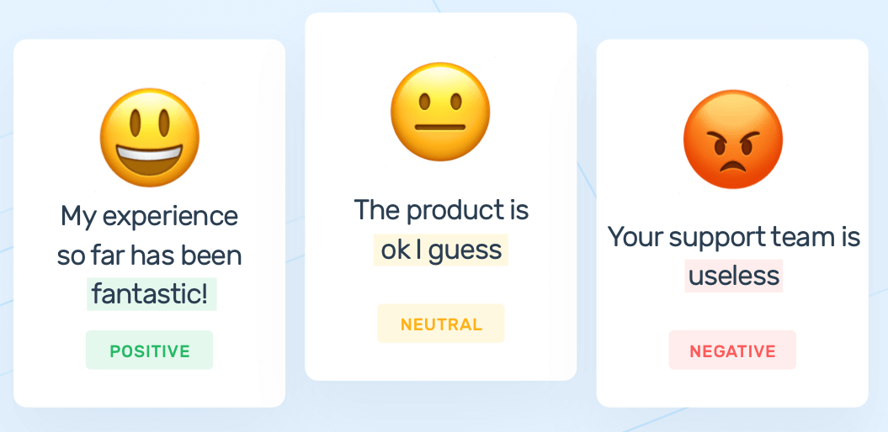
What is Sentiment Analysis ?
Sentiment analysis, also known as opinion mining, is a subfield of Natural Language Processing (NLP) that focuses on determining the sentiment or emotional tone expressed in a piece of text. The goal of sentiment analysis is to understand and interpret the subjective information present in the text, whether it is positive, negative, or neutral.
It’s also known as opinion mining, deriving the opinion or attitude of a speaker.

Slide 6
What is Sentiment Analysis ?
Sentiment analysis is a new field of research born in Natural Language Processing (NLP), aiming at detecting subjectivity in text and extracting and classifying opinions and sentiments.
There are three types of techniques for Sentiment Classification: (i) machine learning approach, (ii) lexicon-based approach and (iii) hybrid approach.
The machine learning approach is used for predicting the polarity of sentiments based on trained as well as test data sets. Machine learning uses a supervised approach when there is a finite set of classes (positive and negative). This method needs labeled data to train.
In a machine learning-based classification a training set is used by an Model to learn the different characteristics of documents, and a test set is used to validate the performance of the Model.

Slide 7
2.
Importance Of Sentiment Analysis

Slide 8
Why is Sentiment Analysis Important ?
1. Understanding Customer Feedback: By analyzing the sentiment of customer feedback, companies can identify areas where they need to improve their products or services.
2. Reputation Management: Sentiment analysis can help companies monitor their brand reputation online and quickly respond to negative comments or reviews.
3. Political Analysis: Sentiment analysis can help political campaigns understand public opinion and tailor their messaging accordingly.

Slide 9
Why is Sentiment Analysis Important ?
4. Crisis Management: In the event of a crisis, sentiment analysis can help organizations monitor social media and news outlets for negative sentiment and respond appropriately.
5. Marketing Research: Sentiment analysis can help marketers understand consumer behavior and preferences, and develop targeted advertising campaigns.
6. Public Actions: Sentiment analysis also is used to monitor and analyze social phenomena, for the spotting of potentially dangerous situations and determining the general mood of the blogosphere.

Slide 10
3.
Methodology

Slide 11
Methodology Of Sentiment Analysis
1.
2.
3.
4.
Training and Evaluating The Machine Learning Model
Data Pre Processing
Data Collection
Train Test Split

Slide 12
Methodology Of Sentiment Analysis
1. Data Collection :
Data collection in sentiment analysis refers to the process of gathering relevant textual data from various sources to analyze and determine the sentiment expressed within the text.
2. Data Pre-Processing :
Data preprocessing in sentiment analysis refers to the steps taken to clean, transform, and prepare the raw textual data for analysis. It is a crucial step in the natural language processing (NLP) pipeline, aiming to enhance the quality of the data and improve the performance of sentiment analysis models.
The steps involved in data pre-processing are as follows :

Slide 13
Data Pre-Processing
• Text Cleaning: Clean the text data by removing irrelevant information, such as URLs, special characters, and emojis. This step helps in preparing the text for analysis.
• Tokenization: Break down the text into individual words or tokens. This step is crucial for the subsequent analysis, as it helps in understanding the structure of the text.
• Stopword Removal: Eliminate common words (stopwords) that do not carry much meaning. This helps reduce noise in the data and focuses on the more meaningful terms.
• Stemming or Lemmatization: Reduce words to their root form to standardize the text. For example, "running" and "ran" might be reduced to the common root "run."

Slide 14
Methodology Of Sentiment Analysis
3. Train Test Split :
Refers to the process of dividing your dataset into two subsets:
Training Set: The training set is a portion of the dataset used to train or teach the sentiment analysis model. During this phase, the model learns patterns and relationships within the data to make predictions about sentiment.
Test Set: The test set is a separate portion of the dataset that the model has not seen during training. It is used to evaluate the model's performance and assess how well it can generalize to new, unseen data.

Slide 15
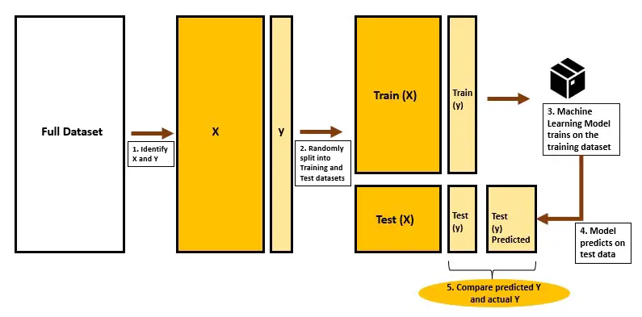

Slide 16
Methodology Of Sentiment Analysis
4. Training and Evaluating The Machine Learning Model :
Model training in sentiment analysis involves using a machine learning or deep learning algorithm to teach the model how to recognize patterns and relationships in the data that correspond to different sentiments (positive, negative, or neutral).
The steps involved are :
Text Vectorization: Convert the textual data into a numerical format that the model can understand.
Model Selection: Choose a suitable sentiment analysis model. Depending on the complexity of the task and the size of the dataset, E.g. : Logistic Regression

Slide 17
Training and Evaluating The Machine Learning Model
Model Evaluation:
After training is complete, we use the test set to evaluate the model's performance. Input the test set into the trained model, and compare the model's predictions with the actual sentiments in the test set.
Performance Metrics:
Calculate performance metrics such as accuracy score to assess how well the model is performing on the test set.

Slide 18
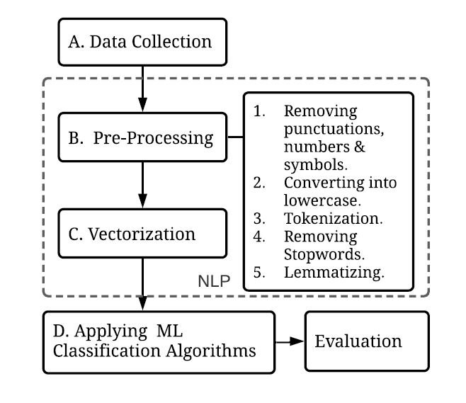
Methodology Of Sentiment Analysis

Slide 19

4.
Twitter Sentiment Analysis

Slide 20
Twitter Sentiment Analysis
Twitter sentiment analysis analyzes the sentiment or emotion of tweets. It uses natural language processing and machine learning algorithms to classify tweets automatically as positive, or negative based on their content.
These data are useful in understanding the opinions of people on social media for a variety of topics.
Now Let us apply the sentiment analysis to a Twitter dataset and classify tweets as positive or Negative :

Slide 21
1. Data Collection :
(i) We are going to use the Sentiment140 Dataset from Kaggle.
It contains 1,600,000 tweets extracted using the twitter API. The tweets have been annotated (0 = negative, 1 = positive) and they can be used to detect sentiment.
It contains the following 6 fields:
target: the polarity of the tweet (0 = negative,1 = positive)
id: The ID of the tweet ( 2087)
date: the date of the tweet (Sat May 16 23:58:44 UTC 2009)
flag: The query (lyx). If there is no query, then this value is NO_QUERY.
user: the user that tweeted (robotickilldozr)
text: the text of the tweet (Lyx is cool)Twitter

Slide 22
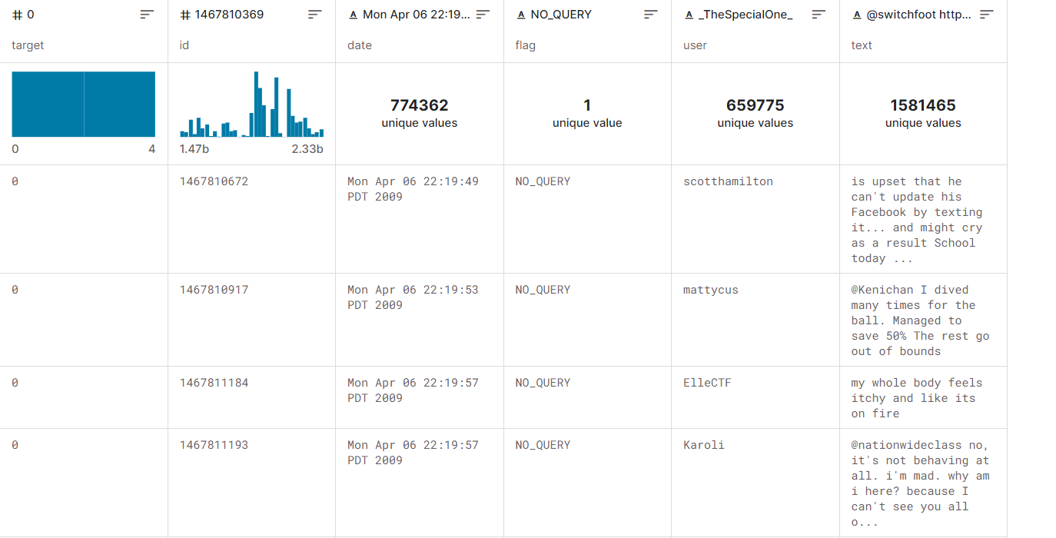
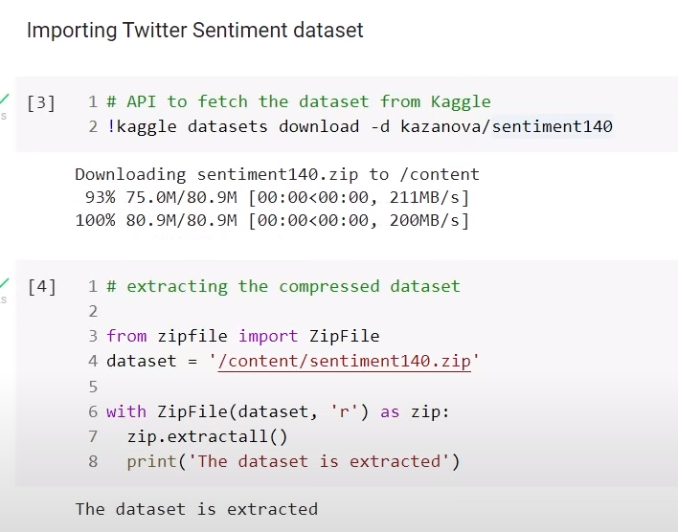

Slide 23
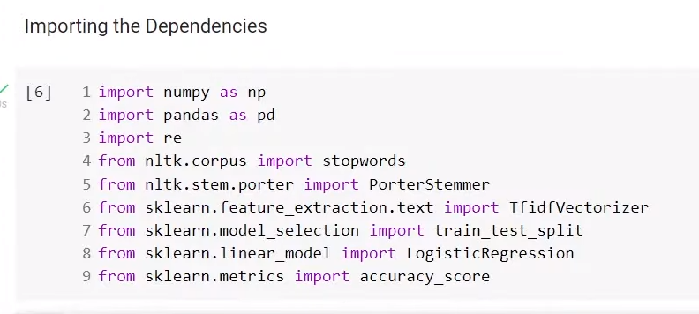
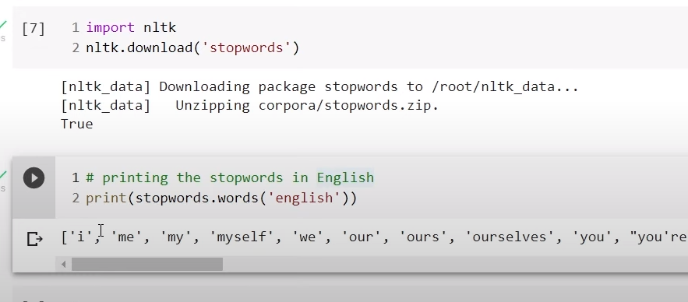
(ii) Importing All Necessary Dependencies :
We are Going to use Pandas, as the dataset is a CSV file and it is easier to handle them as data frames
Regular Expressions and Stopwords and PorterStemmer will be useful for us in the Data Pre-Processing Stage and are taken from the Natural Language Processing Tool Kit (NLTK).
TfidfVectorizer is used to Vectorize the data. We need the train_test_split to separate the training set and the test set from the original dataset.
The Machine Learning Model we are going to use is LogisticRegression as this is a classification problem.
We evaluate the performance of our Model using the accuracy_score.

Slide 24
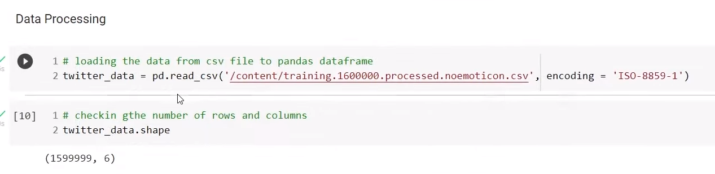
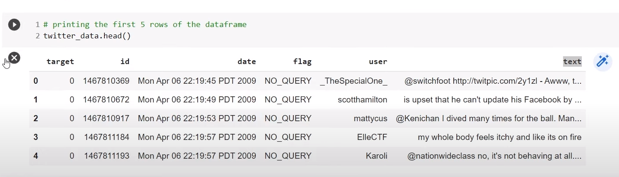
2. Data Pre-Processing :
(i) Loading and Verifying the Dataset.

Slide 25
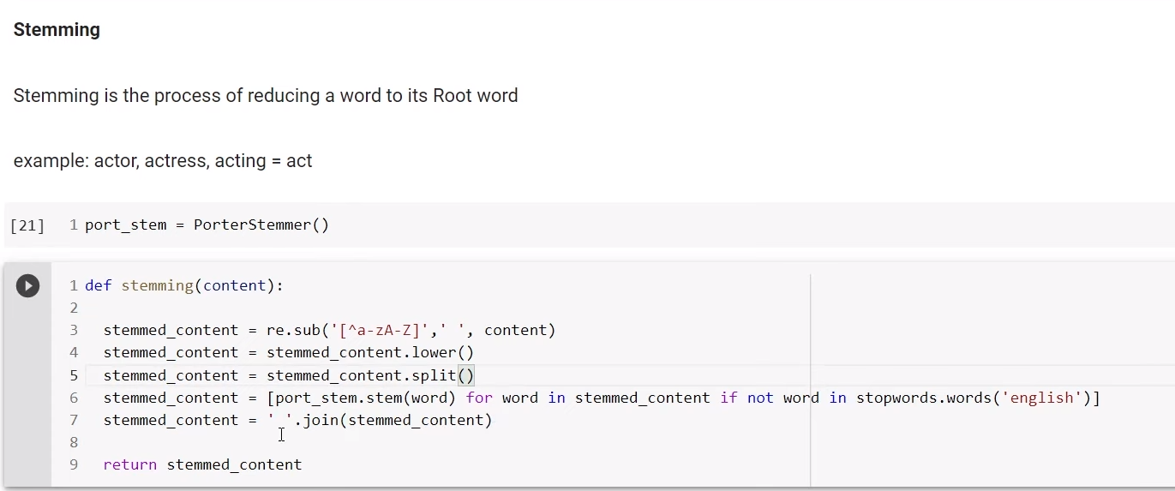
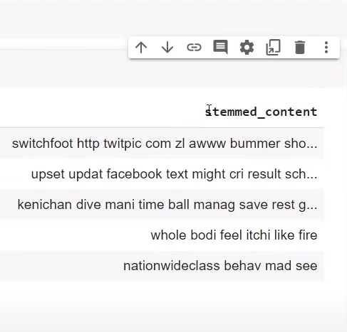
2. Data Pre-Processing :
(ii) Stemming :
Here, We remove everything from the ‘text’ column that isn’t an alphabet, and we Stem every word of the data and filter out the stopwords.
We create a new column ‘stemmed_content’ which we are going to use in further processing.

Slide 26
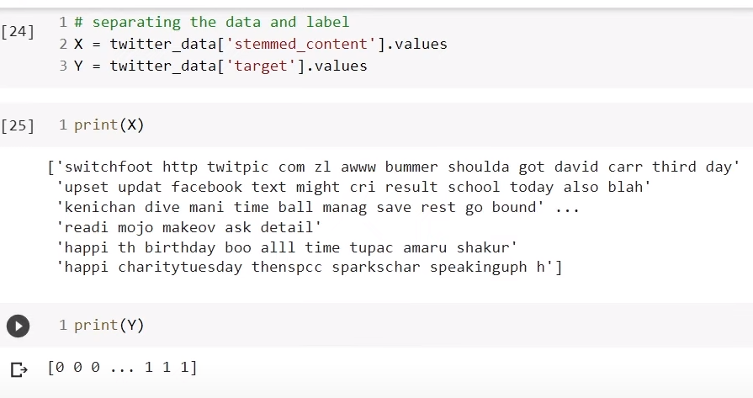
3. Train-Test Split:
(i) Splitting Target and Stemmed Content :
We assign X the data present in ‘stemmed_content’, similarly we assign Y the respective ‘target’ values.
We do this to make the test-train split easier.

Slide 27
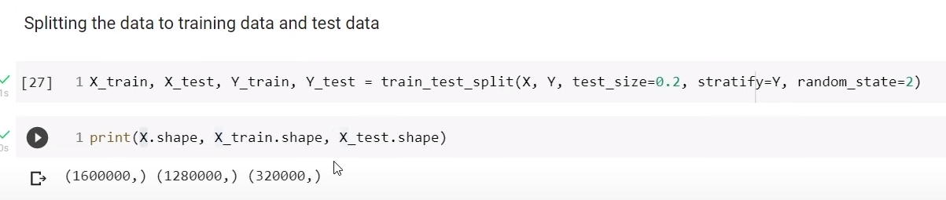
3. Train-Test Split:
(ii) Applying Train-Test Split:
We split the dataset into X_train, X_test and Y_train, Y_test.
‘ train_test_split() ’ performs the splitting
‘test_size = 0.2’ defines that 20% of the data set will be used for the Test Set.
Remaining 80% will be used for Train set i.e. training the model

Slide 28
3. Train-Test Split:
(iii) Vectorization:
TF-IDF Vectorizer is a valuable tool for converting raw text data into a format suitable for machine learning models.
TF-IDF stands for Term Frequency-Inverse Document Frequency.
It is a numerical statistic that reflects the importance of a word in data
‘vectoriser.transform(X_train)’ transforms the training text data.
‘vectoriser.transform(X_test) ‘ transforms the testing text data.

Slide 29
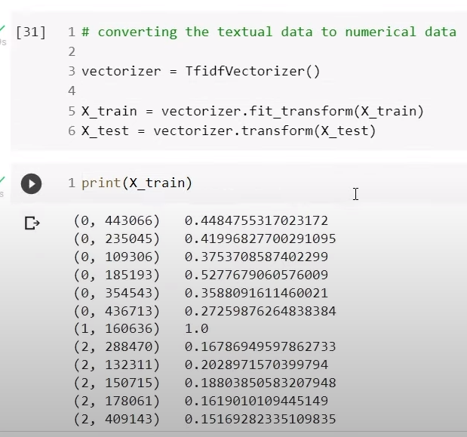

Slide 30
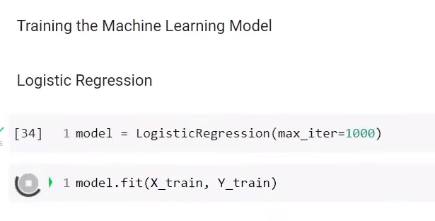
4. Training The Machine Learning Model :
We Feed the Data present in the Train Set for Training our Machine Learning Model.
We are Using the Logistic Regression Model.
max_iter=1000: Setting the maximum number of iterations.
model.fit(X_train, Y_train): Training the model with the training data.

Slide 31
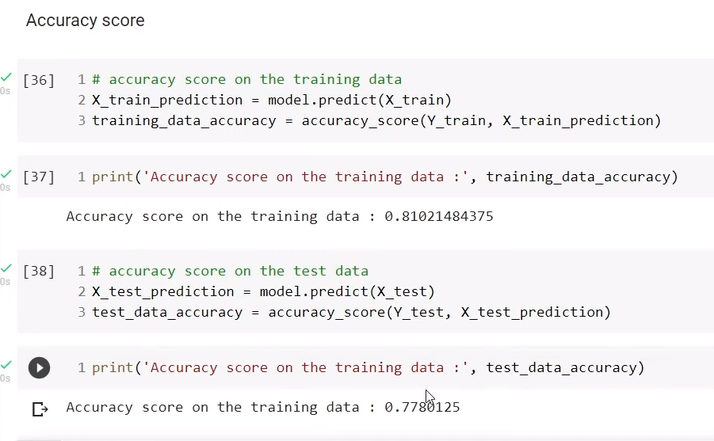
5. Evaluating The Machine Learning Model :
Here, we evaluate the performance of our trained model.
‘ X_train_prediction = model.predict(X_train) ‘ will use the trained model to predict the labels for the training data.
‘ accuracy_score(Y_train, X_train_prediction) ‘ will Calculate the accuracy of the model’s predictions.

Slide 32
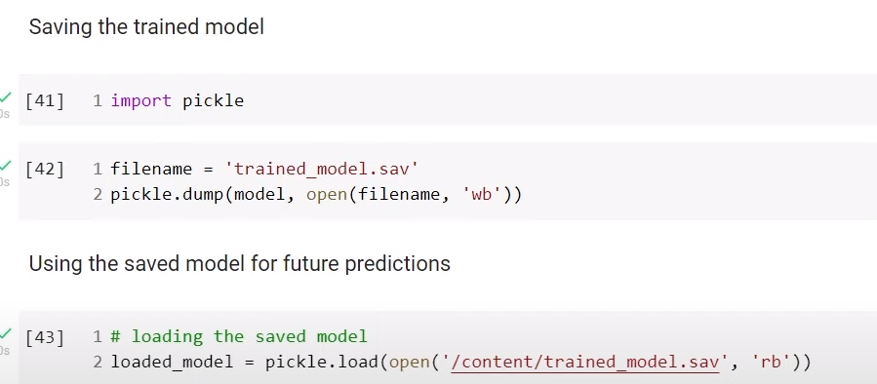
5. Saving The Machine Learning Model :
we use the pickle library to save, open, and load our ML model.

Slide 33
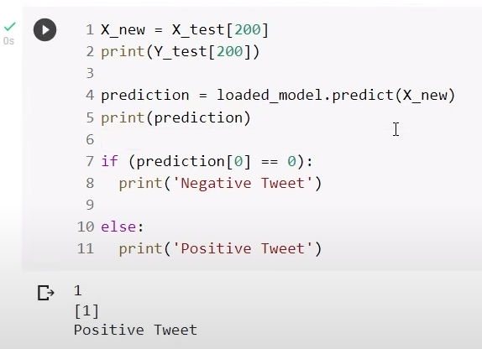
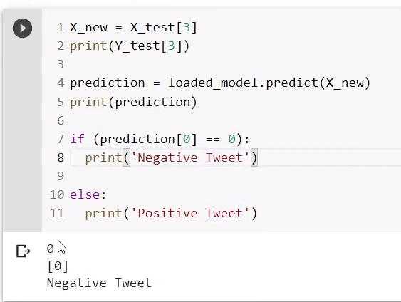
6. Deploying The Trained Machine Learning Model :
The Trained Model is put to use here.
‘ Y_test[200] ’ gives the respective true Target value on the 200th index
‘ X_new ’ gives Predicted Target value on the 200th index

Slide 34
5.
Conclusion

Slide 35
Conclusion
Machines can’t process text-based data, so we have to convert to numerical form in order to process the data.
Simplifying and filtering text can achieve cleaner data to process, giving better results.
We have explored the Twitter Sentiment Analysis as a classification machine learning project. The data has been preprocessed. We have classified a tweet as a negative sentiment or a positive sentiment.
We have successfully created a Machine That can classify tweets based on their emotion.

Slide 36
Thank
You

